Slide 1

Graphics: Rendering Basics
COMP4451 Game Programming

Slide 2
Rendering pipeline outline
Underlying concepts and algorithm
(This set of slides; recap from Graphics intro)
WebGL basics and GPU shading
(Next set of slides)

Slide 3
GPU processing at a glance
Application
Vertex Processor
Rasterizer
Pixel Processor
Memory
Display

Slide 4
Programmability (later)
Application
Vertex Processor
Programmable
SIMD on GPU
“Shaders”
Rasterizer
Pixel Processor
Memory
Display

Slide 5
Processing geometry
Application
Vertex Processor
Rasterizer
Pixel Processor
Memory
Display

Slide 6
Geometry transformation
From object coordinates to screen coordinates

Slide 7
Geometry
Composed of two parts
Vertex data in a vertex array/buffer
Primitives in an index/element array/buffer
Vertices must include a position
Color, texture coordinates,… optional
Primitives reference one or more vertices
Triangles, lines, points
Geometry transformations act on vertices
And as a consequence change primitives too

Slide 8
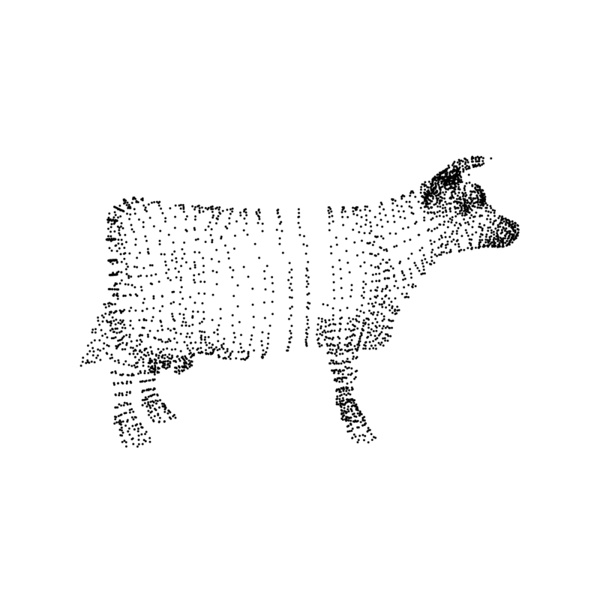

Slide 9
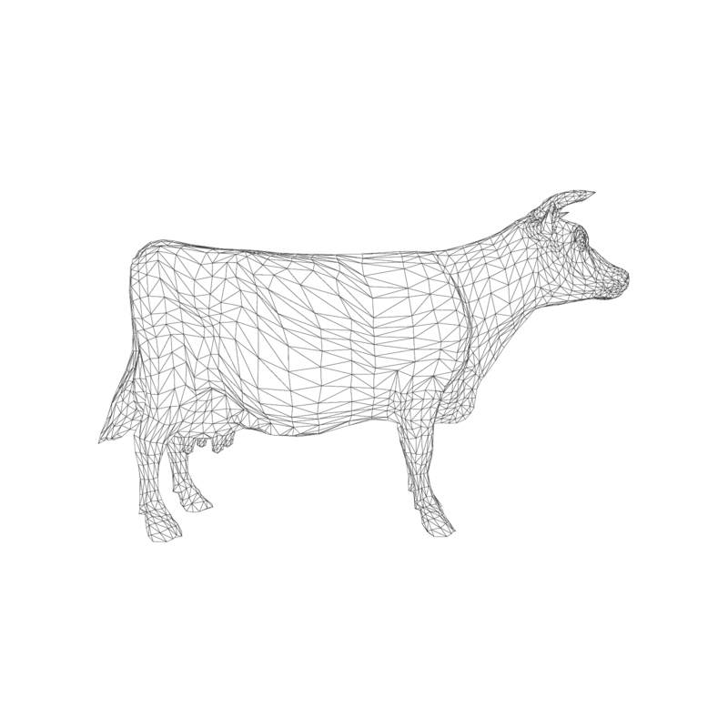

Slide 10
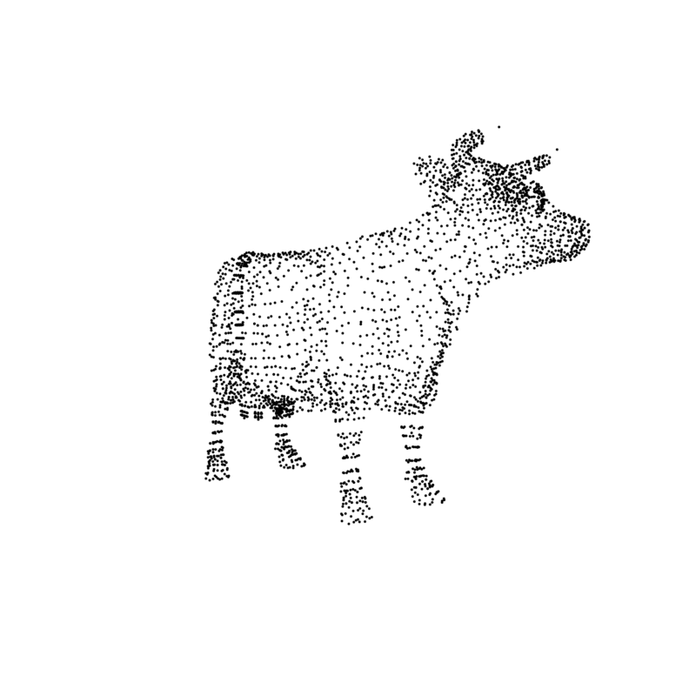

Slide 11
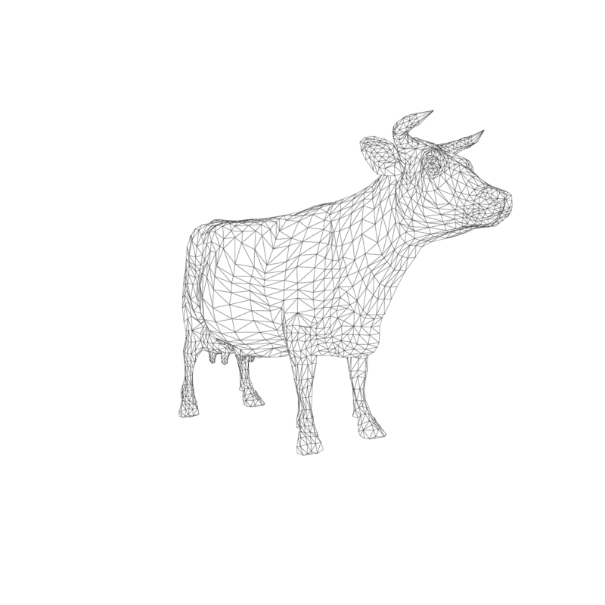

Slide 12

Vertex transformation
Object or Model Coordinates
World Coordinates
Eye or Camera Coordinates
Device Coordinates
Window or Screen Coordinates
Clip Space
Modeling
transformation
Viewing
transformation
Projection
transformation
Perspective
division
Viewport
transformation
Notes:
Details in hidden slides (covered in graphics class)

Slide 13
Points, P (x, y, z)
Gives us a position in relation to the origin of our coordinate system

Slide 14
Vectors, V (x, y, z)
Is a direction in 3D space
Points != Vectors
Point – Point = Vector
Vector+Vector = Vector
Point + Vector = Point

Slide 15

Vectors V
Length (modulus) of a vector V (x, y, z)
|V| =
A unit vector: $\frac{V}{|V|}$

Slide 16
Dot (scalar) product
b
θ
a
a · b = |a| |b| cosθ
a · b = x_{a} · x_{b} + y_{a} · y_{b} + z_{a} · z_{b}

Slide 17
Projections (of b on a)
b
θ
a
a · b = |a| |b| cosθ
Assume |a|=|b|=1, then just cosine of angle
What if it is <0? ==0? >0?

Slide 18
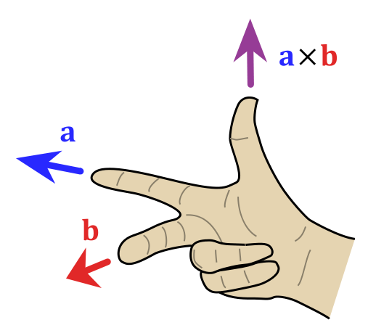
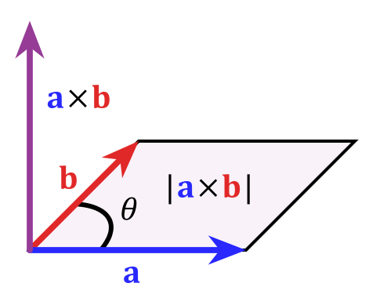
Cross (vector) product
Cross product orthogonal to two initial vectors
Direction determined by right-hand rule
Useful in constructing coordinate systems (later)

Slide 19
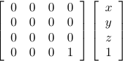
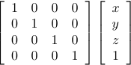
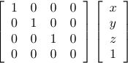
Positions in homogeneous coordinates
Borrowed from projective geometry
To each point (x,y,z) in R³, associate a line (x,y,z,w) in R⁴
The line goes through the origin and (x,y,z,1)
To go from R⁴ to R³, divide by w: (x/w, y/w, z/w)
Linear transformations in this space are more powerful

Slide 20
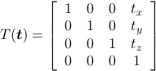
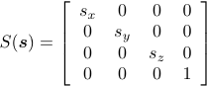
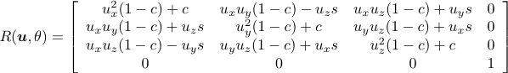
Modeling transformations
Object coordinates to World coordinates
Position, scale and orient objects in the world
Translation
Scaling
Rotation

Slide 21
Vertex transformation
Object or Model Coordinates
World Coordinates
Eye or Camera Coordinates
Device Coordinates
Window or Screen Coordinates
Clip Space
Modeling
transformation
Viewing
transformation
Projection
transformation
Perspective
division
Viewport
transformation

Slide 22

Viewing transformation
World coordinates to Eye/Camera coordinates
Combination of Translation and Rotation
Typically specified with: Eye, center, up

Slide 23
Vertex transformation
Object or Model Coordinates
World Coordinates
Eye or Camera Coordinates
Device Coordinates
Window or Screen Coordinates
Clip Space
Modeling
transformation
Viewing
transformation
Projection
transformation
Perspective
division
Viewport
transformation

Slide 24
Orthographic projection

Slide 25
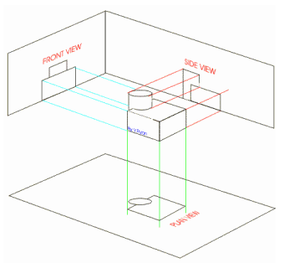
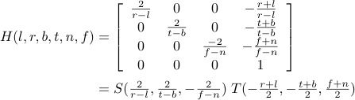
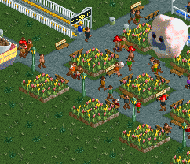
Orthographic projection

Slide 26
Perspective projection

Slide 27
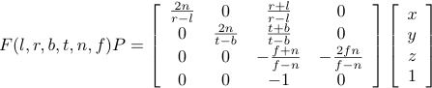
Perspective projection

Slide 28
Vertex transformation
Object or Model Coordinates
World Coordinates
Eye or Camera Coordinates
Device Coordinates
Window or Screen Coordinates
Clip Space
Modeling
transformation
Viewing
transformation
Projection
transformation
Perspective
division
Viewport
transformation

Slide 29

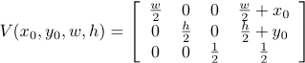
Viewport transformation

Slide 30
Rasterizing
Application
Vertex Processor
Rasterizer
Pixel Processor
Memory
Display

Slide 31
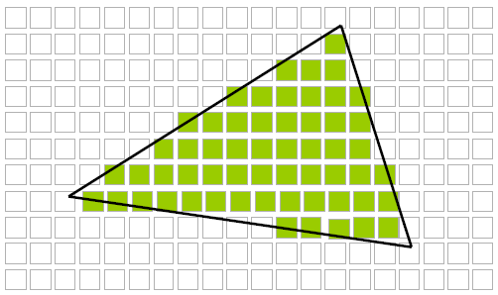
Rasterization
From vertices and primitives to pixels

Slide 32
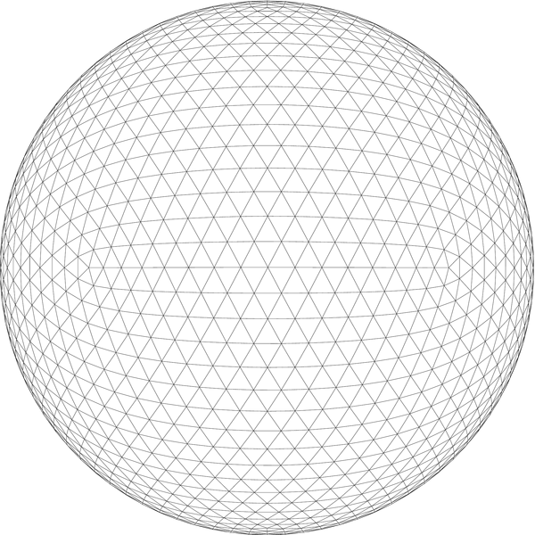
Before we start

Slide 33
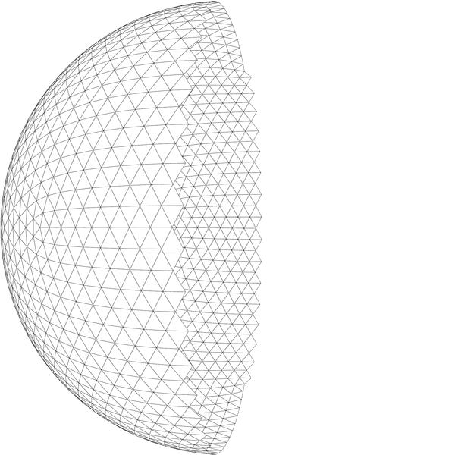
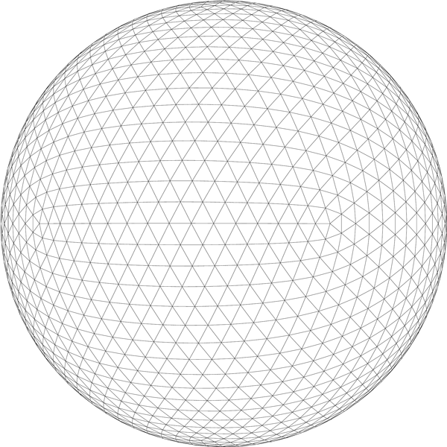
Front-faces

Slide 34
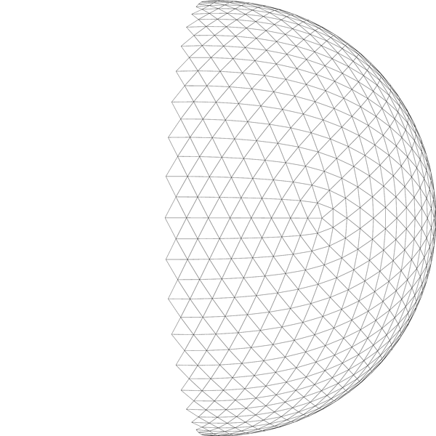
Back-faces

Slide 35
Backface culling
Don’t rasterize back-facing triangles
Or front-facing, you decide
Points and lines are always rasterized
One possible implementation
Look at 2D screen coordinates
Cross product Two possible orientations: A = (v2-v1)x(v3-v1).z
2
2
3
3
1
1

Slide 36
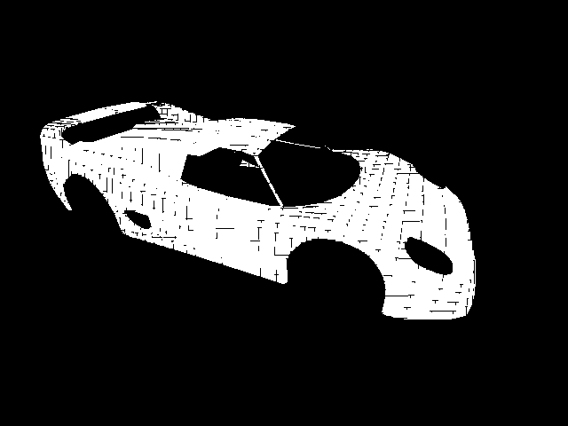
What if triangles share an edge?
Missing or repeated fragments
Neither triangle emits, both of them emit
Cracks or overdraw (when blending)
Image from “Advanced Rasterization”, Nicolas Capens, 2004

Slide 37
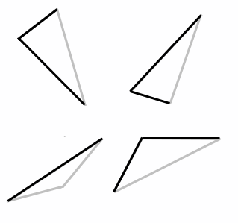
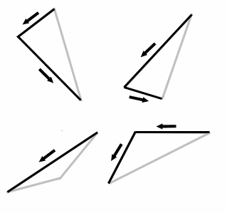
The top-left rule
Pixel center inside: emit fragment
Center on edge: emit if top edge or left edge
Top edges are horizontal and above all others
Left edges are not horizontal and are to the left
Triangles can have one or two left edges
Image from “Advanced Rasterization”, Nicolas Capens, 2004
Notes:
Looking at the counter clockwise vertex order, left edges are aways going down.
The top edge is horizontal, and the x goes left.

Slide 38
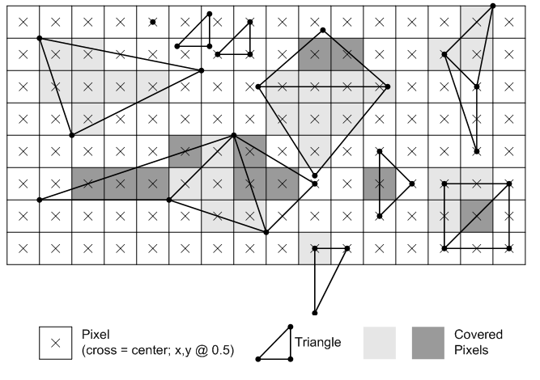
Top-rule examples
Image from “Microsoft’s Direct3D 10 Rasterization Rules”, 2010

Slide 39
Processing pixels
Application
Vertex Processor
Rasterizer
Pixel Processor
Memory
Display

Slide 40
Lighting and shading
So far, we’ve concentrated on geometry rendering
What is the shape of an object?
How do I place it in a virtual 3D space?
How do I view it through my virtual camera?
How do I know which pixels it covers?
Once we’ve answered all those, we have to ask one more important question:
What value do I set each pixel to?

Slide 41
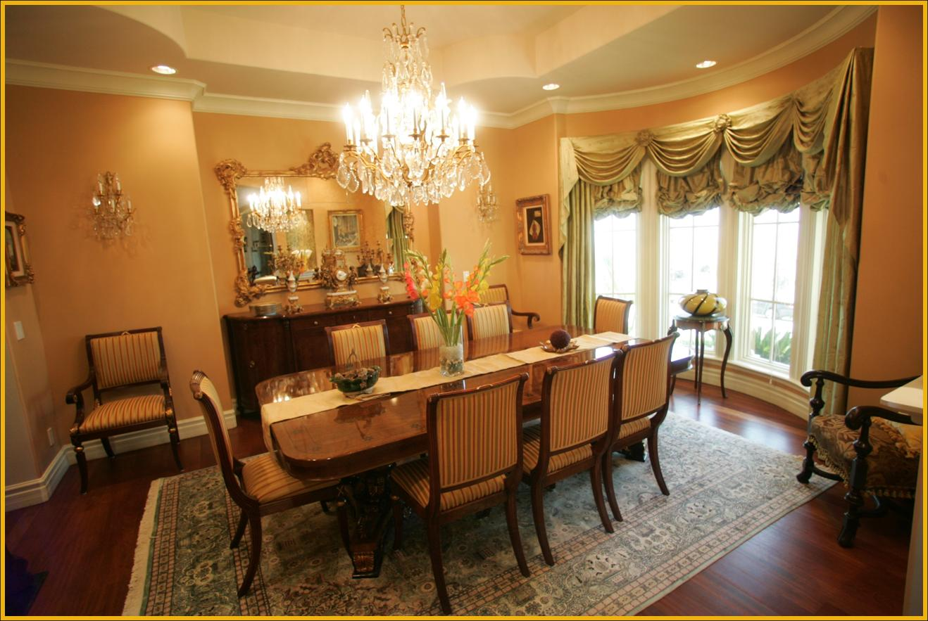
How to set the color of each pixel?
Look around the room!

Slide 42
Difficult task
Properly determining the right color is really hard.
There are trillions of photons, which can
interact with the atmosphere
strike a surface and
be absorbed
be reflected
cause fluorescence or phosphorescence
Of course, none of the surfaces here are perfectly flat. At some microscopic level (very important for photons) they’re all really bumpy.

Slide 43
Light Source
What is a light source?
Any object that emits radiant energy
Types of light source:
Directional
Point
Spot light
Advanced: extended and environment

Slide 44
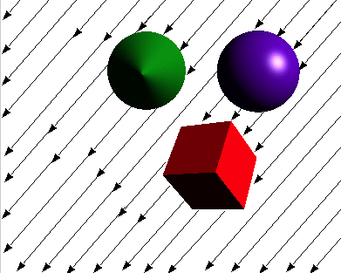
Directional Light Source
The light source is at infinity
Incoming light rays are parallel and of same intensity
Easy to compute because the incoming light direction is the same for all surface points

Slide 45
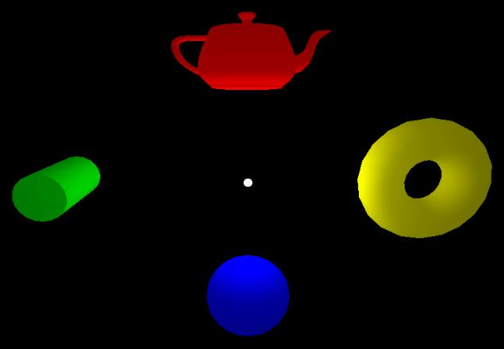
Point Light Source
A zero-volume light source located at a finite distance from the surface
Light rays goes out from the source in all directions
Harder to compute with because incoming light direction varies at each surface point
Distance attenuation: Can specify how the light goes dimmer with distance

Slide 46
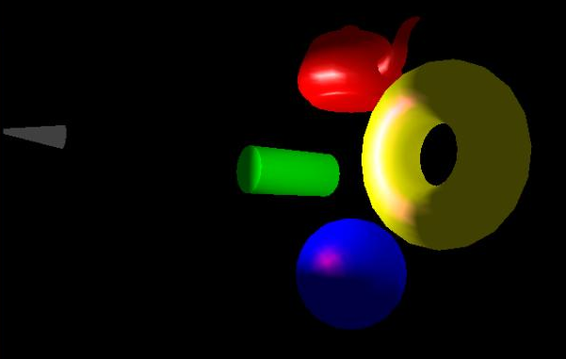
Spot Light Source
γ
Special Point Light pointing at particular direction (inherits all properties of point light source)
A cutoff angle restricts the shape of light emitted from source
In addition to distance attenuation, we may attenuate the intensity of light by measuring its deviation from the spotlight pointing direction

Slide 47

Extended Light Source
Extended Light Source, e.g. Line or Area (fluorescent lamp)
Every point along the line or within the area is a point light source
More Realistic, but computation is often very expensive
Produces soft shadows: umbra and penumbra
No direct support in OGL/DX.

Slide 48
Phong illumination model
Approximation to how light interacts with surfaces
It has the following characteristics:
Not physically based
Approximation to physical light reflection
Very fast
Widely used
Supported in graphics hardware

Slide 49
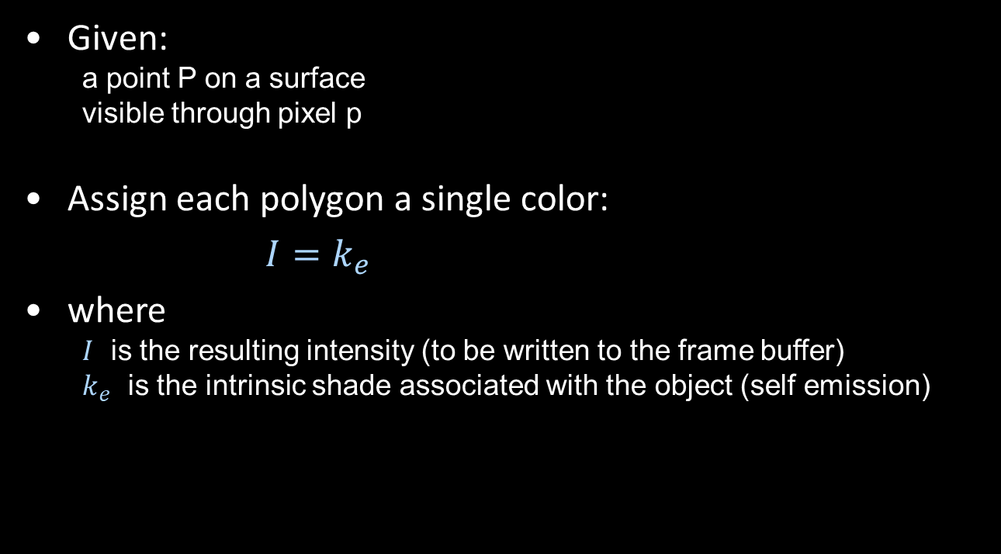
1. Emissive term
Given:
a point P on a surface
visible through pixel p
Assign each polygon a single color:
$I=k_{e}$
where
$I$ is the resulting intensity (to be written to the frame buffer)
$k_{e}$ is the intrinsic shade associated with the object (self emission)

Slide 50
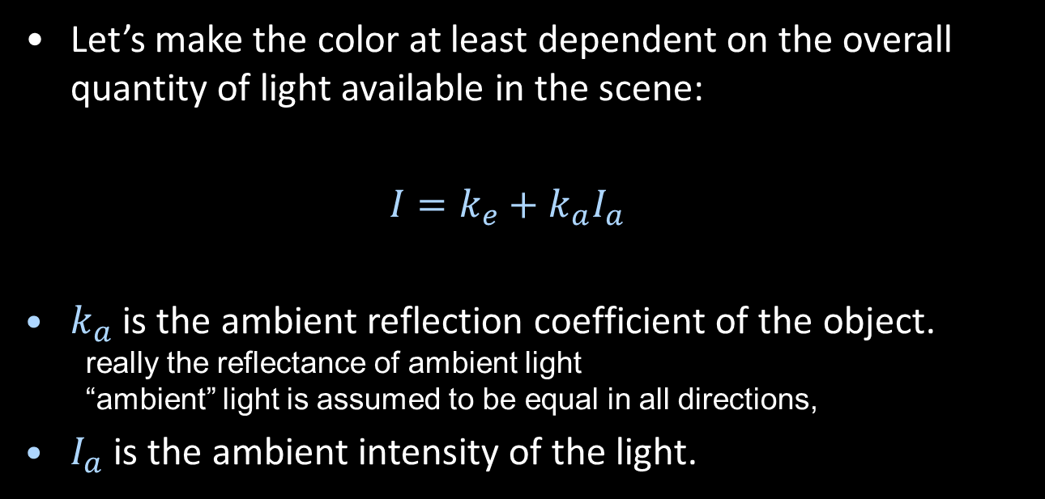
2. +Ambient term
Let’s make the color at least dependent on the overall quantity of light available in the scene:
$I=k_{e}+k_{a}I_{a}$
$k_{a}$ is the ambient reflection coefficient of the object.
really the reflectance of ambient light
“ambient” light is assumed to be equal in all directions,
$I_{a}$ is the ambient intensity of the light.

Slide 51
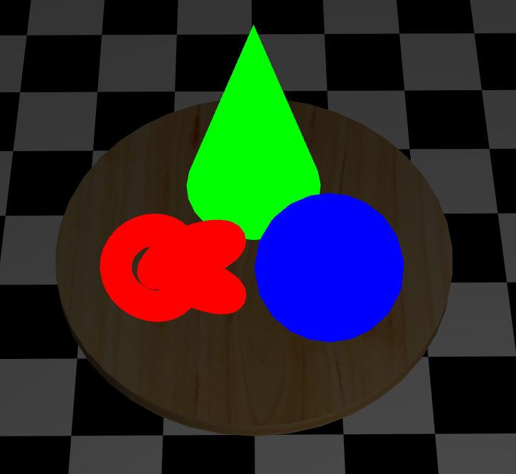
Ambient lighting
Very crude approximation of indirect ilumination: Simply assume the indirect lighting is constant (same at all surface points)

Slide 52
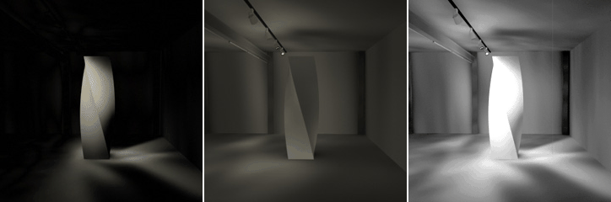
Indirect Illumination
Some surfaces are illuminated even if in shadow. Why?
Indirect lighting reflected from other surfaces
Each surface illuminated becomes itself a source of light for illumination on other surfaces of the scene.
The ambient term is a crude approximation of that.
Direct
Indirect
Direct + Indirect

Slide 53
Diffuse Reflection
Let’s examine the ambient shading model:
objects have different colors
we can control the overall light intensity
what happens when we turn off the lights?
what happens as the light intensity increases?
what happens if we change the color of the lights?
So far, objects are uniformly lit.
not the way things really appear
in reality, light source contributions are directional

Slide 54
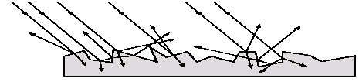
Diffuse Reflector
Diffuse, or Lambertian reflection will allow reflected intensity to vary with the direction of the light.
Diffuse reflection occurs from dull, matte surfaces, like latex paint, or chalk.
These diffuse or Lambertian reflectors reradiate light equally in all directions.
Picture a rough surface with lots of tiny microfacets.
Light may actually penetrate the surface, bounce around, and then reflect back out.
Not dependent on direction of the viewer!

Slide 55
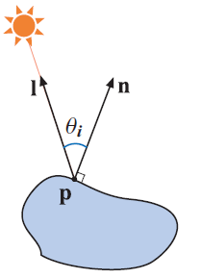
Lambert’s cosine Law
A diffuse surface is one which reflects light equally in all directions and obeys Lambert’s cosine law
I₀ is the incoming light intensity I is the reflected light intensity

Slide 56
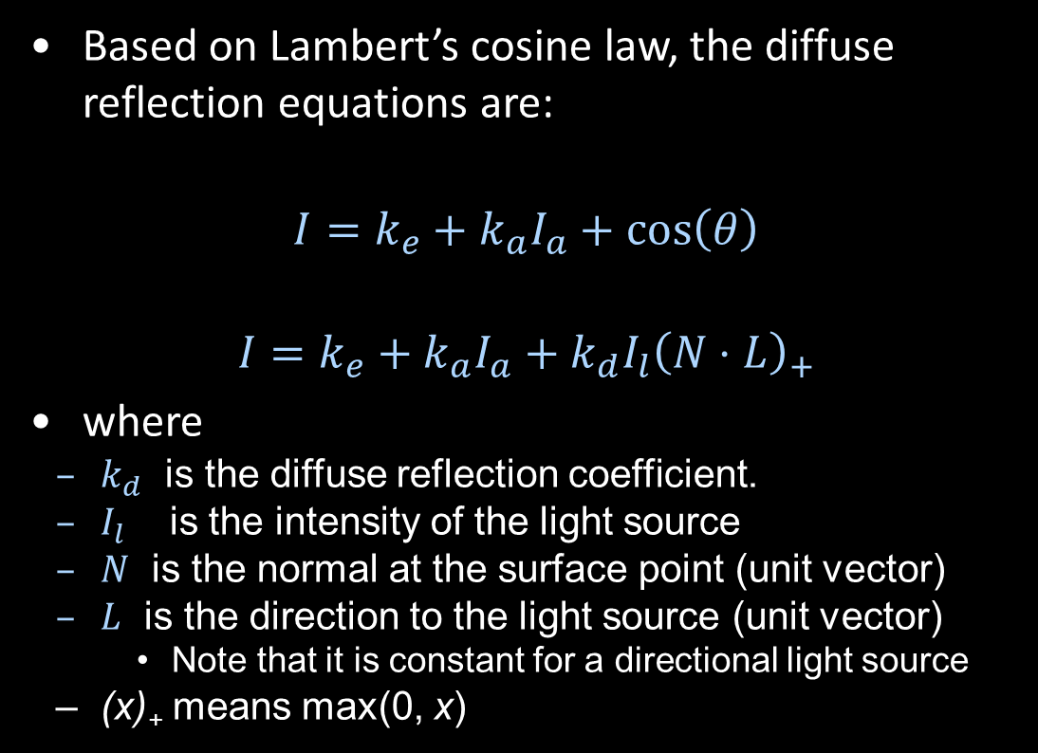
3. +Diffuse term
Based on Lambert’s cosine law, the diffuse reflection equations are:
$$I=k_{e}+k_{a}I_{a}+\cos\left(θ\right)$$
$$I=k_{e}+k_{a}I_{a}+k_{d}I_{l}{\left(N⋅L\right)}_{+}$$
where
$k_{d}$ is the diffuse reflection coefficient.
$I_{l}$ is the intensity of the light source
$N$ is the normal at the surface point (unit vector)
$L$ is the direction to the light source (unit vector)
Note that it is constant for a directional light source
(x)₊ means max(0, x)

Slide 57
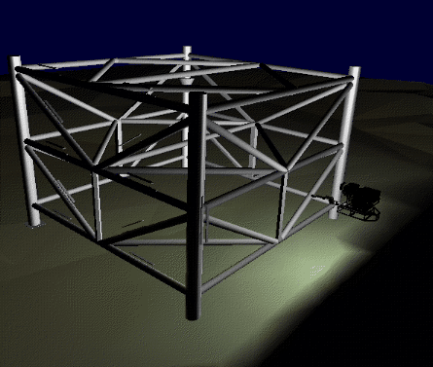
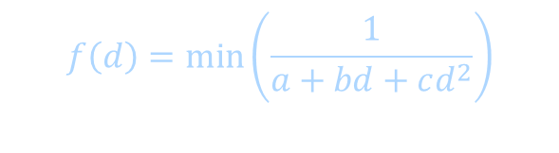
Light attenuation with distance
The laws of physics state that the intensity of a point light source must drop off with its distance squared.
We can incorporate this effect by multiplying by 1/d².
Sometimes, this distance-squared drop off is considered too “harsh”
It is common to use user-supplied constants for a, b, c:
$$f\left(d\right)=\min\left(\frac{1}{a+bd+cd^{2}}\right)$$

Slide 58
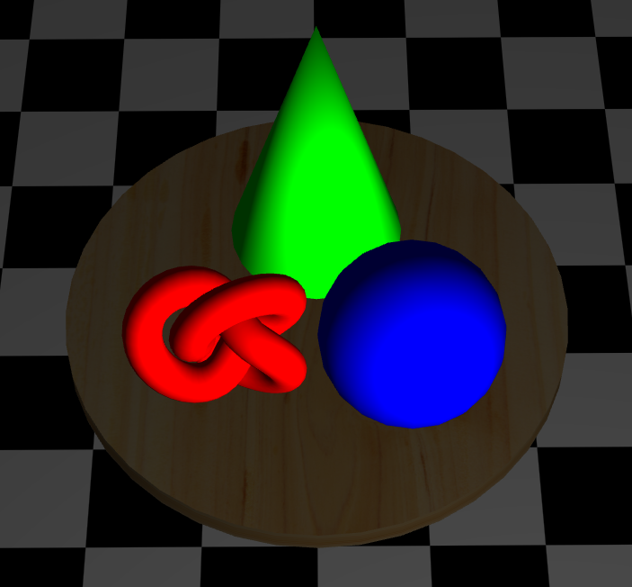
Diffuse lighting
(ambient)
Try increasing the diffuse coefficient

Slide 59
Specular Reflection
Specular reflection accounts for the highlight that you see on some objects.
It is particularly important for smooth, shiny surfaces, such as:
metal
polished stone
plastics
Apples
Specular reflection also depends on the viewing direction V. The color is often determined solely by the color of the light.

Slide 60
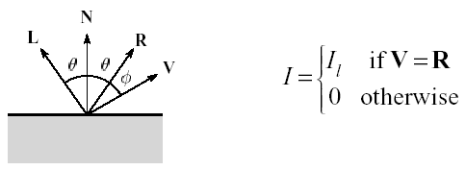
Specular Reflection
For a perfect mirror reflector, light is reflected about N, so
For a near-perfect reflector, you might expect the highlight to fall off quickly with increasing angle φ.
Also known as:
“rough specular” reflection
“directional diffuse” reflection
“glossy” reflection

Slide 61
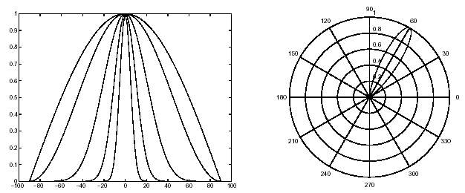
Specular Reflection
One way to get this effect is to take (R · V), raised to a power n_{s} .
As ns gets larger,
the dropoff becomes more abrupt
gives a smaller highlight

Slide 62
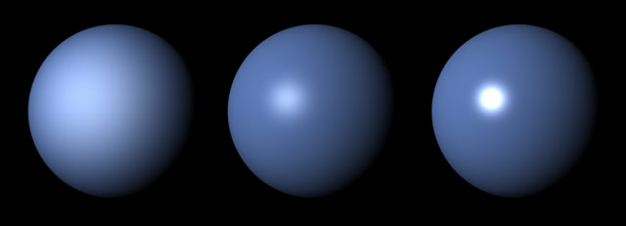
Specular Examples
Effect on varying n_{s}:
Increasing n_{s}

Slide 63
Specular Reflection
Note: Changing the light direction

Slide 64
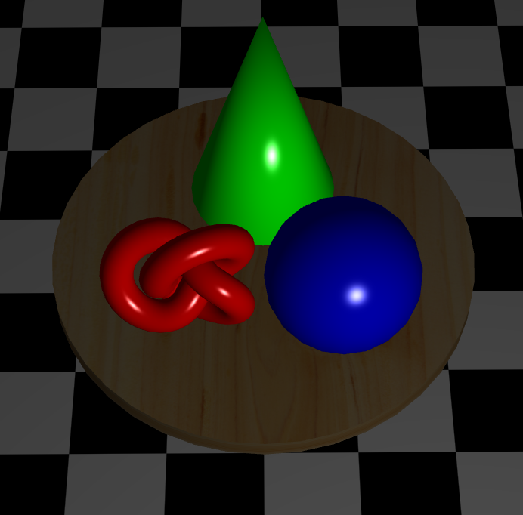
Diffuse + specular
(ambient)
(+diffuse)

Slide 65
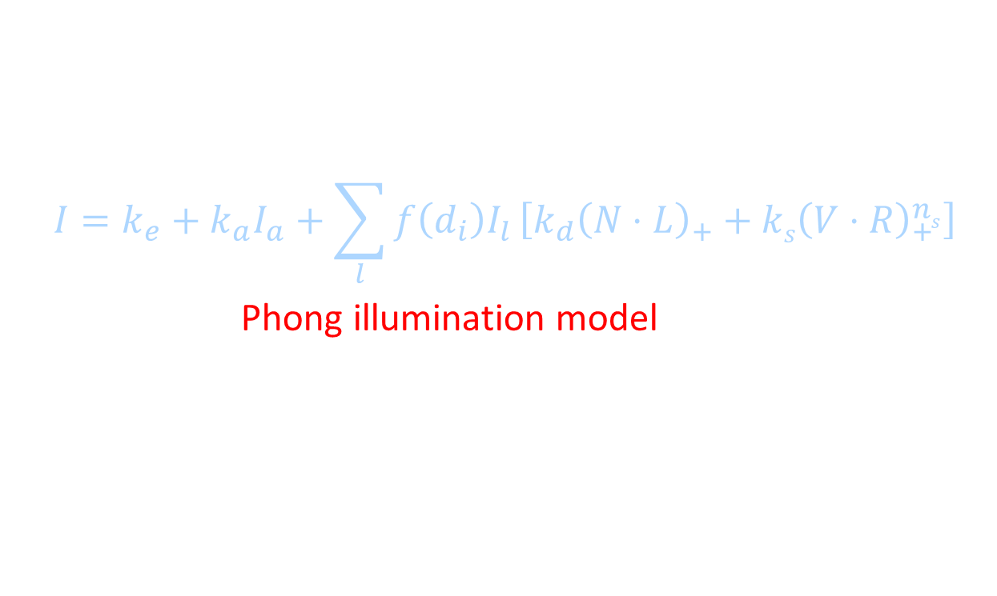
4. Entire model
Since light is additive, we can handle multiple lights by taking the sum over every light.
Our equation is now:
$$I=k_{e}+k_{a}I_{a}+\sum_{l}{f\left(d_{i}\right)I_{l}}\left[k_{d}{\left(N⋅L\right)}_{+}+ks{\left(V⋅R\right)}_{+}^{ns}\right]$$
This is the Phong illumination model.
Beware of the max. operator ()₊ in the above equation
Which quantities are spatial vectors?
Which are RGB triples?
Which are scalars?

Slide 66
Choosing the Parameters?
Some common guidelines:
Ns in the range [0,100]
Try K_{a} +K_{d} + K_{s} <= 1
Use a small K_{a} (~0.1)
Increase N_{s} and K_{s} for shinny surfaces, like metal, plastic
Increase K_{d} for dull surfaces, like cloth, carpet, cement

Slide 67
Appearance of a
diffuse (dull) sphere
3D plot of reflected intensity

Slide 68
Appearance of a
specular sphere
3D plot of reflected intensity
n = 15

Slide 69
k_{d} = 0.7
k_{s} = 0.4
n = 15

Slide 70
k_{d} = 0.85
k_{s} = 0.25
n = 15

Slide 71
Summary for the four components
in the Phong Illumination model
 | Emission (0th iteration) | Ambient (1st iteration) | Diffuse (2nd iteration) | Specular (3rd iteration)
Depends on surface property | Y | Y | Y | Y
Depends on light intensity | N | Y | Y | Y
Depends on light direction | N | N | Y | Y
Depends on viewing direction | N | N | N | Y
71

Slide 72
Summary for Phong Model
The most important thing to take away from this section is the final equation for the Phong model.
What is the physical meaning of each variable?
How are the terms computed?
What effect does each term contribute to the image?
What does varying the parameters do?
Note:
It allows us to compute the color emitted along a given viewing direction from a given surface point
This is still an approximation for light-surface interaction; this is still an active research area: there are a number of more complicated models.
Phong Shading online demos:
http://home.cse.ust.hk/~psander/metarenderer/
http://www.cs.toronto.edu/~jacobson/phong-demo/

Slide 73
Shading interpolation
Flat shading
Gouraud shading
Phong shading

Slide 74
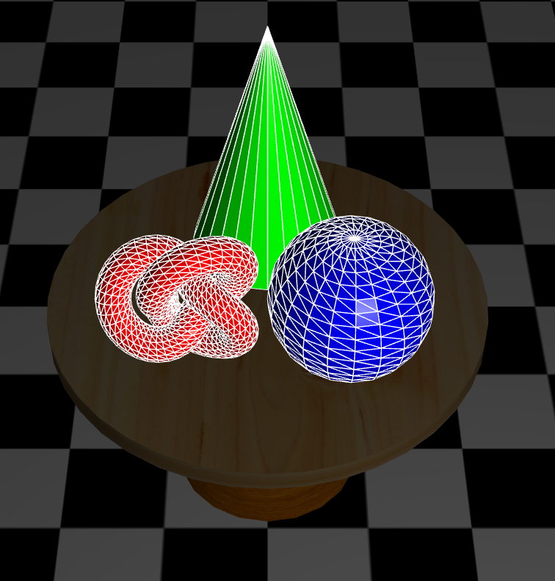
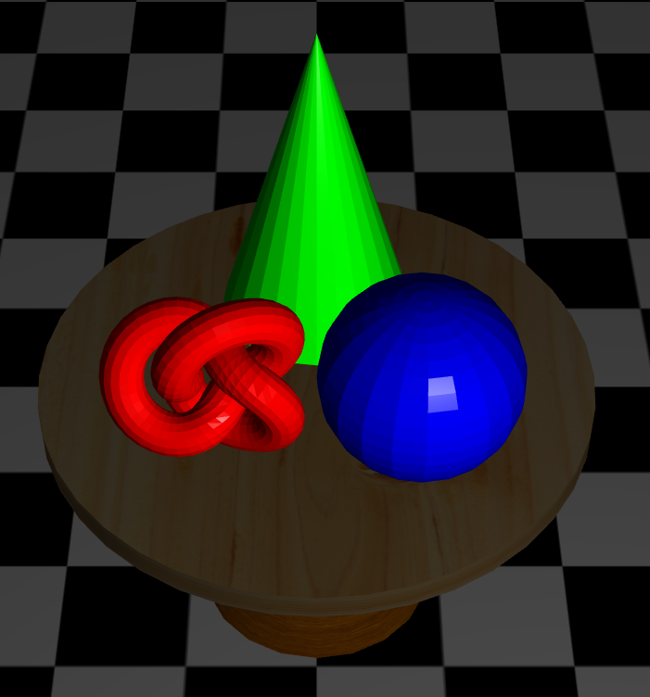
Flat shading
Single color across each triangle
Uses triangle normal

Slide 75
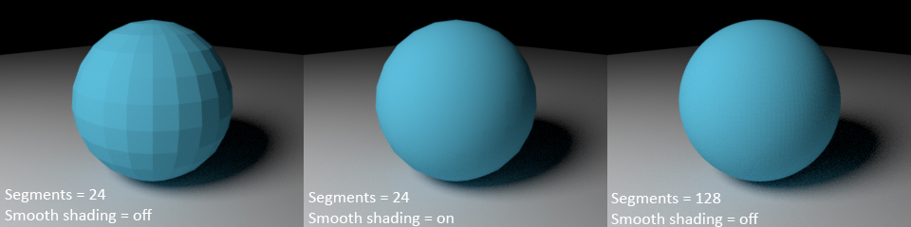
Gouraud shading
Shade at vertices
Interpolate color across triangle
Smoother result across triangles
Does not require increase in number of triangles

Slide 76
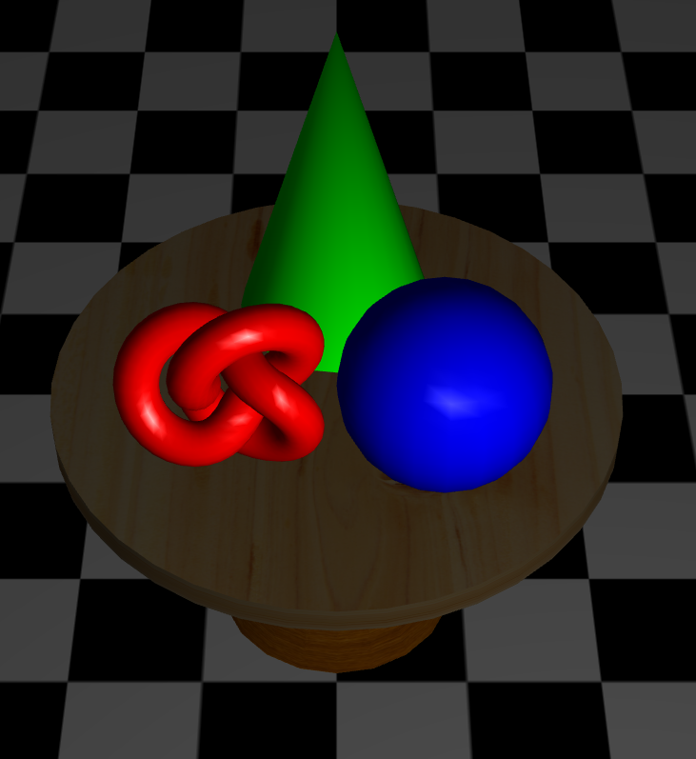
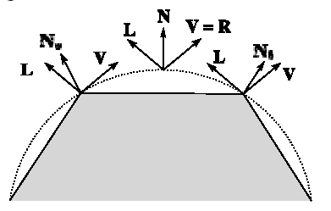
Gouraud shading
Gouraud shading fails to capture highlights at the interior of the triangle
It only interpolates vertex colors

Slide 77

Phong shading
Interpolate vertex normals across triangle
Shade at pixels
Much smoother result, no interpolation artifacts
Does not miss highlights as it computes illumination at every pixel

Slide 78
Phong shading
Interpolate vertex normals across triangle
Shade at pixels
Much smoother result, no interpolation artifacts
Does not miss highlights as it computes illumination at every pixel
Flat
Gouraud
Phong

Slide 79

Texturing
Modify surface appearance at each point using an image, function, procedure, etc
Image from “ATI Toyshop demo”

Slide 80

Texture images
Mapping from 3D xyz vertex to 2D uv [0-1] texture coordinates
v
u

Slide 81

Texture lookup
Filtering strategy depends on sampling
i.e., on mapping between screen and textures
Depends on geometry & projection too!
Screen space
Texture space

Slide 82
Magnification
Hardware supports nearest and linear filtering
Linear filtering is free
It is also not particularly good
Nearest
Linear

Slide 83




Nearest magnification

Slide 84




Linear magnification

Slide 85




Interpolating cubic B-spline magnification
(not supported natively in hardware)

Slide 86








Even better magnification
Possible with vector graphics
Resolution independent information

Slide 87

Minification
Harder than magnification
Many alternatives
Hardware supported:
Mipmapping
Anisotropic filtering
Can we take all pixels into consideration in real-time?
How?

Slide 88

Mipmapping
Precomputed levels of detail in a pyramid
Pick the closest two, and interpolate their results

Slide 89
Hardware support for mipmapping
Use local derivative to compute level of detail
Nearest
Select nearest pyramid level
Sample from it
Nearest or linear
Linear
Find neighboring pyramid levels
Sample both
Nearest or linear
Blend results linearly
Sometimes called trilinear filtering

Slide 90

Mipmapping memory requirements
Not even twice the number of bytes!
Only ~33% more
$$\sum_{i=0}^{∞}{{\left(\frac{1}{4}\right)}^{i}= \frac{4}{3}}$$

Slide 91

Anisotropic filtering
What if mapped pixel is not square?
Take more than 1 sample
More samples in longer direction (done by GPU)
Just MIPmapping
Anisotropic filtering

Slide 92
Other uses of texture mapping
Environment maps
Normal maps and bump maps
Displacement maps
…

Slide 93


Environment mapping (EM) for reflection
[Images from RTR]

Slide 94


Generating and storing the EM
Use a “Cube map”
Render environment to the six faces
[Image from RTR]

Slide 95


Refraction
Same strategy using EM
Use Snell’s law to compute refraction vector t
Simple implementation does not consider exit interface
[Images from RTR]

Slide 96


Bump mapping
Blinn methods:
Store displacements
Displace the normal n using b_{u} , b_{v} values sampled from bump map
Normalize resulting vector
Store a heightfield
Compute above displacements by sampling nearby texels
[Image from RTR]

Slide 97

Normal mapping
Instead of displacement, store actual normal directly
Often just stores x and y components of unit vector
z derived directly up to sign
[Image from Paolo Cignoni]

Slide 98

Displacement mapping
Tessellates and displaces surface in the normal direction
Displacement map is a height field texture map
Can be applied on vertex shader or during tessellation (covered later)
[Image from Wikipedia]

Slide 99
Summary
Rendering basics
Rendering pipeline stages
Interpolative shading
Texturing

